Slide 1
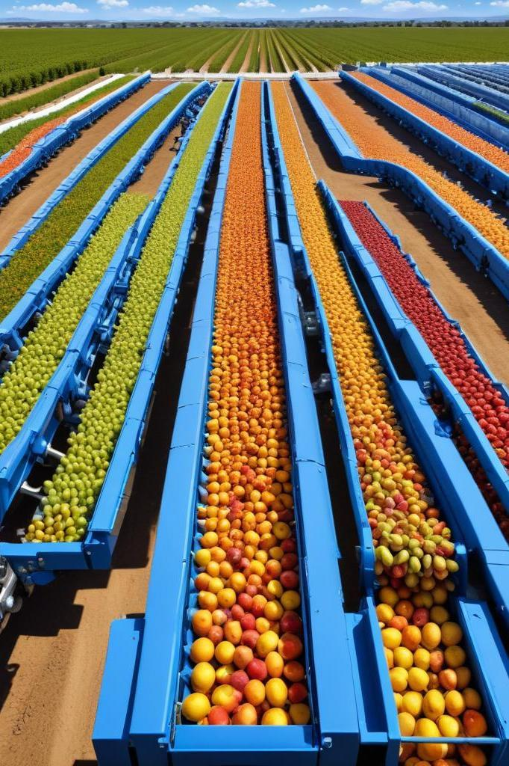
Automation of Fruit Sorting
Enhancing Efficiency and Quality in Agriculture

Slide 2
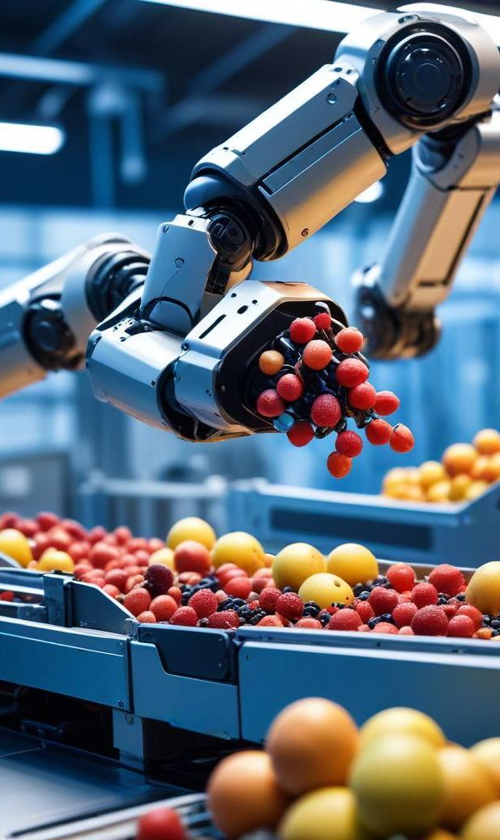
Introduction
In modern agriculture, fruit sorting plays a critical role in ensuring only high-quality products reach consumers. Automation is rapidly transforming this process, providing consistency, efficiency, and hygiene. This presentation explores the advancements in automated fruit sorting systems utilizing robotic arms and vision technology.

Slide 3
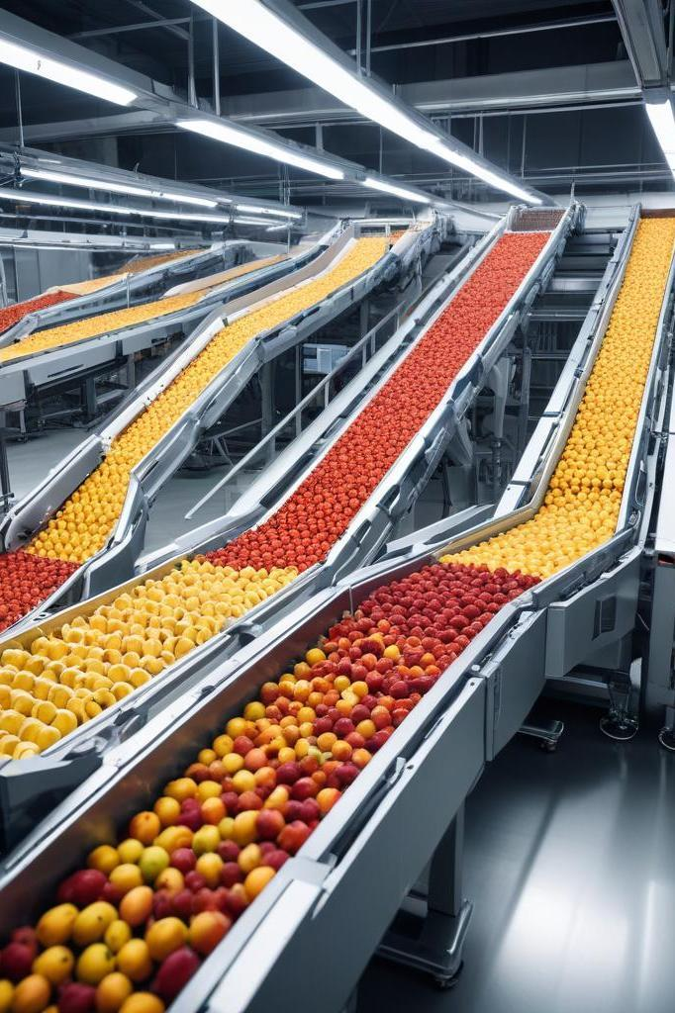
01
Introduction
Fruit sorting involves classifying fruits based on attributes such as size, shape, color, weight, texture, and ripeness. This post-harvest process ensures that only marketable fruits are sold, while defective ones are discarded or processed further. Manual sorting based on visual inspection is traditional but lacks consistency and efficiency. In contrast, machine-based sorting uses sensors and algorithms to analyze fruit characteristics and sort accordingly.

Slide 4
Importance of Fruit Sorting
Fruit sorting is essential to post-harvest management as it ensures that only fruits meeting quality standards are sold to consumers. This process directly impacts the marketability and safety of fruits, contributing to waste reduction and improved overall efficiency in the supply chain.

Slide 5
Traditional vs Automated Methods
Traditional fruit sorting methods rely heavily on manual labor, resulting in variability in outcomes, labor costs, and time consumption. In contrast, automated methods utilize advanced sensors and algorithms, leading to rapid and precise sorting based on multiple attributes such as size, shape, and color.

Slide 6
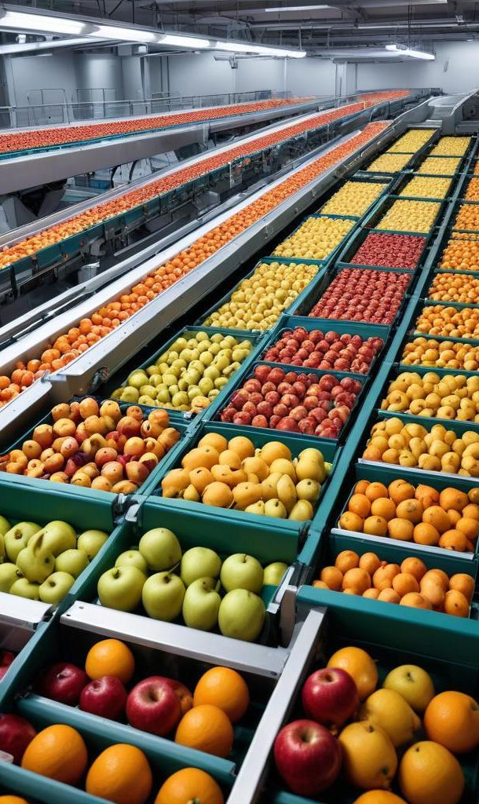
Impact on Quality and Efficiency
Automated fruit sorting systems significantly enhance both quality and efficiency in the agricultural sector. By reducing human error and increasing the speed of sorting, these systems ensure that only the best fruits are selected for market. The application of precise machine vision technologies minimizes the risk of misclassification, promoting higher standards of quality control and optimizing the overall fruit supply chain.

Slide 7
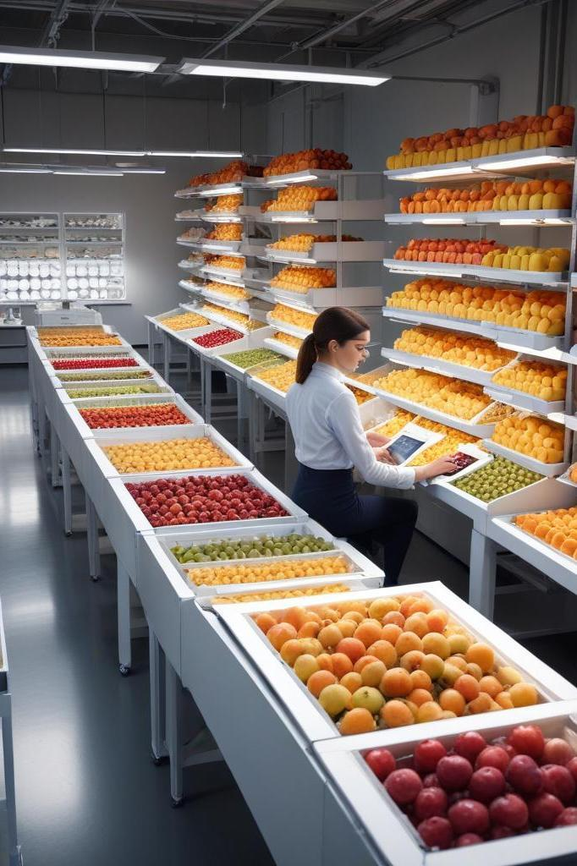
02
Literature Review
Lue et al. [1] developed a system using color and shape to sort fruits with up to 95% accuracy at 400 fruits per minute.
Classification accuracy:
Size & Shape: >95%.
Spoilage: >90%
Maturity: >93%.
Sorting throughput: Capable of processing 400 fruits per minute.

Slide 8
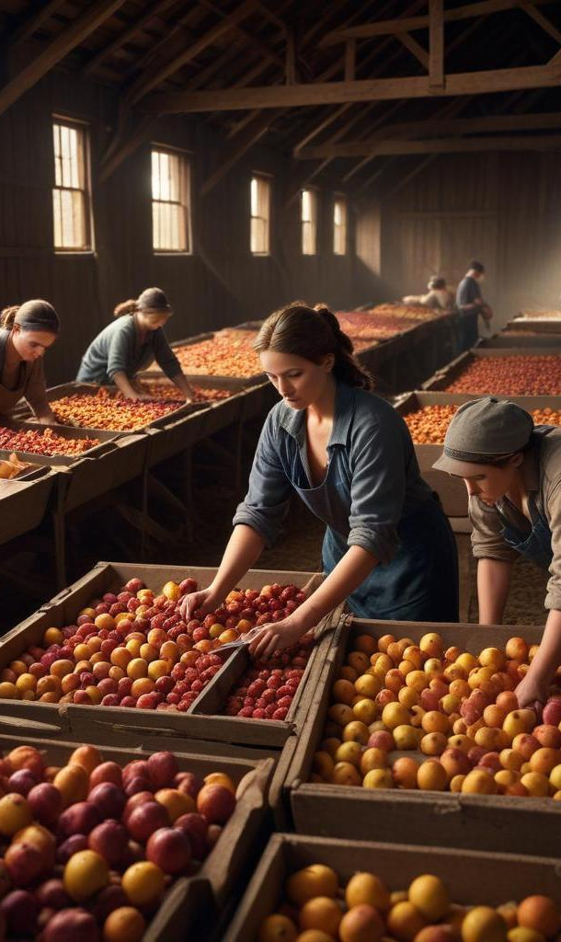
Challenges in Traditional Sorting
Traditional methods of fruit sorting face several challenges including labor-intensive processes, potential for human error, and inconsistency in sorting results. Workers may struggle to meet quality standards due to fatigue and subjective judgments, leading to variable outcomes that can impact the overall fruit quality and marketability.

Slide 9
Advancements in Automation
Recent advancements in automation technologies have transformed fruit sorting, with the introduction of Robot Arm Control systems and sophisticated algorithms. These innovations enable rapid processing speeds of up to hundreds of fruits per minute, maintaining accuracy and reliability. Implementing robotics and AI facilitates precise sorting based on predetermined quality criteria like size, shape, and color.

Slide 10
Machine Vision in Fruit Sorting
Machine vision systems leverage image processing and deep learning to classify fruits based on visual attributes. These systems can detect flaws like bruises or rot and classify fruits with remarkable accuracy. By incorporating machine learning models, the technology continues to evolve, resulting in improved sorting performance and higher quality assurance in the fruit processing industry.

Slide 11
Conclusions
The integration of automation and machine vision in fruit sorting represents a pivotal advancement for the agricultural industry. By significantly improving sorting accuracy and operational efficiency, these technologies not only enhance product quality but also streamline processing workflows, ultimately meeting the growing demands for quality and safety in the food supply chain.
https://colab.research.google.com/drive/19_IeJX59_oogGQAKwxT_aJkNsEuX9hgv?usp=sharing

Slide 12

Thank you!
Do you have anhttps://colab.research.google.com/drive/19_IeJX59_oogGQAKwxT_aJkNsEuX9hgv?usp=sharinghttps://colab.research.google.com/drive/19_IeJX59_oogGQAKwxT_aJkNsEuX9hgv?usp=sharinghttps://colab.research.google.com/drive/19_IeJX59_oogGQAKwxT_aJkNsEuX9hgv?usp=sharingy questions?
+91 620 421 838

